Slide 1

GROUP 23
STOCK MARKET ANALYSIS
-HARSHITA SHARMA [ 1229053 ]
SUPERVISOR - Dr. J. FIAIDHI

Slide 2

WHY?
Informed Investment Decisions: Stock market analysis provides investors with valuable information and insights about the performance of individual stocks, sectors, and the market as a whole. This information helps investors make informed decisions about buying, selling, or holding their investments.
Risk Management: Analyzing the stock market can help investors assess and manage risks associated with their investments. By understanding market trends, volatility, and potential threats, investors can adjust their portfolios to mitigate risk.
Asset Allocation: Stock market analysis is crucial for determining the appropriate allocation of assets in a portfolio. It helps investors balance their investments between different asset classes, such as stocks, bonds, and cash, to achieve their financial goals while managing risk.

Slide 3
WHY?
Market Timing: Timing is crucial in investing. Analyzing the stock market can help investors identify favorable entry and exit points. This can be especially important for traders who aim to profit from short-term price movements.
Company Performance Evaluation: Investors analyze the stock market to evaluate the financial health and performance of individual companies. This involves examining financial statements, earnings reports, and other relevant data to assess a company's growth potential and profitability.
Long-Term Planning: For long-term investors, stock market analysis is essential for setting and adjusting financial goals. It helps individuals and institutions plan for retirement, education expenses, and other long-term financial objectives.

Slide 4
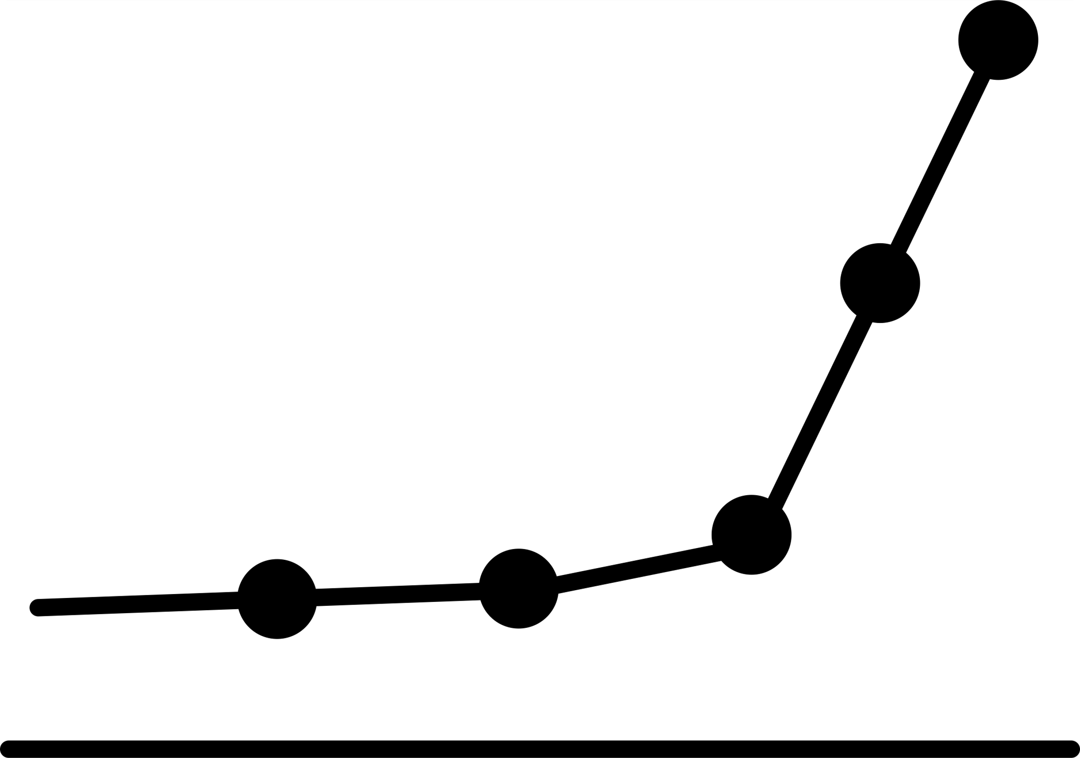
KEY FACTORS AND THEORIES IN STOCK PRICE PREDICTION
This research combines sentiment analysis of news headlines with machine learning techniques.
Subjectivity and Objectivity scores of the news headlines proved to be the most impacting feature for the prediction models followed by the negativity score of the headlines.
Stock market analysis includes two major schools of thought: technical and fundamental analysis. While fundamental analysis looks at the "what" and "why" of stocks, technical analysis concentrates on the "when" and "how."
Many financial economists, researchers, and traders believe that stock prices are at least partially predictable because price changes tend to repeat themselves owing to the collective and patterned behavior of investors
Historical stock market data, fundamental factors, and investors’ psychological behaviors.

Slide 5
KEY FACTORS AND THEORIES IN STOCK PRICE PREDICTION
This proposed model is a well-liked model named is the Recurrent Neural Network (RNN) model. One of the variant of RNN is Long Short Term Memory (LSTM) model.
For classification, XGBoost proved to be the most accurate among the other standard algorithms and models.
For regression, we used a sequential model of multiple LSTM cells to predict the exact prices of the strokes and achieved better results than well-known time series models and regression models.

Slide 6
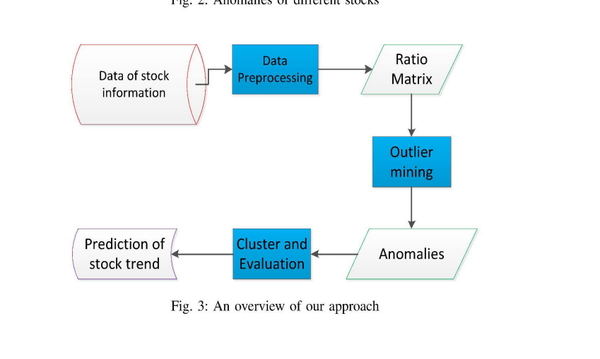
PROCESS FLOW OF OVERALL PREDICTION
ANOMALIES OF DIFFERENT STOCKS

Slide 7
PROPOSED METHODOLOGY
Sentiment Analysis
VADER Lexicon is useful to classify polarity which includes positive, negative, neutral, compound(normalized values of three attributes before) and the strength of these polarities as well.
XGBoost For Classification
trees that are going to be built after the current tree will learn from the updated values of the residual errors.
LSTM For Classification
can have past iterations' information in the larger neural network

Slide 8
STOCK PRICE FORECASTING WITH ML MODELS
The aim of this project is to project the flow of stock prices based on running scenarios and events which affects the industries' economic performance using XGBoost (Classification) and LSTM(Regression) models.
SVM is widely used for text classification and sentiment analysis.
The data is converted into the vector form using the GloVe (Global Vectors for Word Representation) data file which is a collection of words and their vector forms.
Aim of XGBoost: The aim of any boosting algorithm is to build multiple prediction trees sequentially in a manner that every tree tries to reduce the errors of the tree created before it.
Each new tree gets the error values of its predecessor and learns from it and then updates these error values.

Slide 9
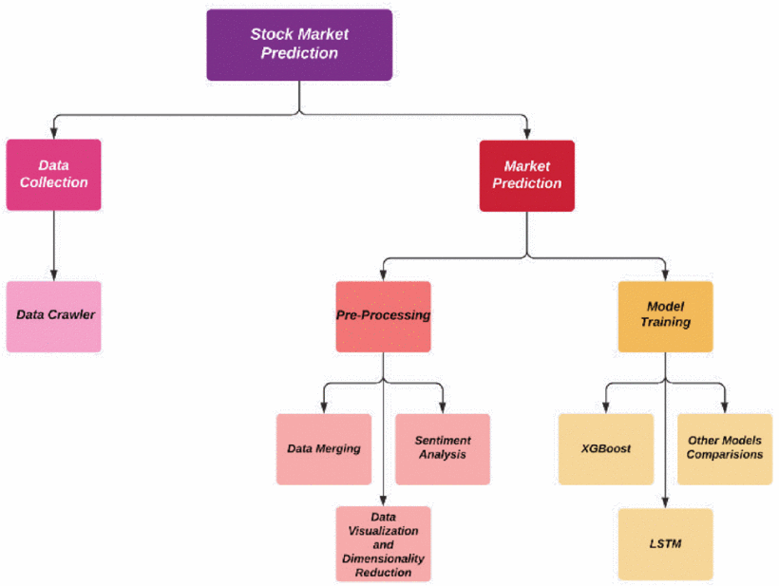
DESIGN & DATA FLOW
Processed data is then fed to the Classification (XGBoost) and Regression (LSTM) models which predict the flow of stock prices (“Raise” or “Fall”)

Slide 10
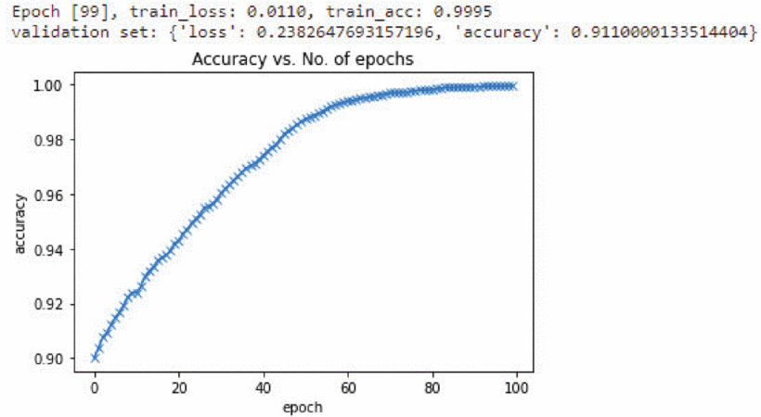
RESULTS
SENTIMENT ANALYSIS

Slide 11
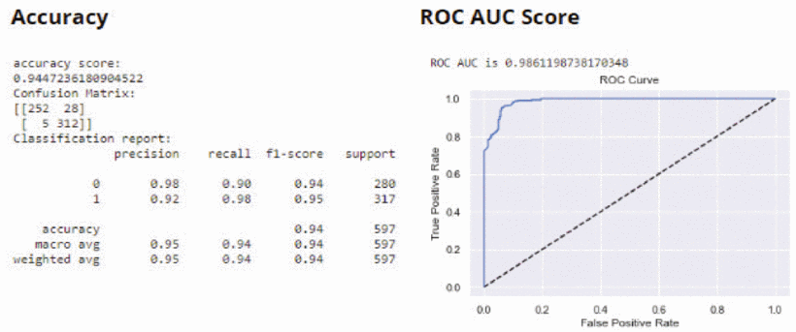
RESULTS
XGBOOST

Slide 12
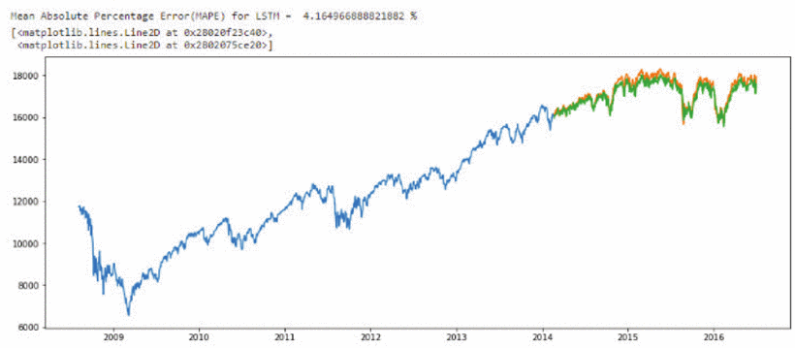
RESULTS
LSTM

Slide 13
SUMMARY
We extracted sentiments like positivity, negativity, neutral, subjectivity and objectivity and used them as an input to our prediction models along with the daily stock market data.
For classification, XGBoost proved to be the most accurate among the other standard algorithms and models. For regression, we used a sequential model of multiple LSTM cells to predict the exact prices of the strokes and achieved better results than well-known time series models and regression models

Slide 14
FUTURE SCOPE
Future changes in stock prices cannot be predicted from the historical data as fluctuations are independent and random but we can always improvise prediction accuracy.
These prediction models can be introduced to some other stock market affecting factors for enhanced and more accurate results.
The models can be merged with some other prediction models as well to build a robust system.

Slide 15
REFERENCES
[1] L. Zhao and L. Wang, "Price Trend Prediction of Stock Market Using Outlier Data Mining Algorithm," 2015 IEEE Fifth International Conference on Big Data and Cloud Computing, Dalian, China, 2015, pp. 93-98, doi: 10.1109/BDCloud.2015.19.URL: https://ieeexplore.ieee.org/stamp/stamp.jsp?tp=&arnumber=7310722&isnumber=7310694
[2] A. Gehlor and R. Singh, "Estimation of Sentiment Analysis Base Stock Market Crisis," 2022 IEEE 3rd Global Conference for Advancement in Technology (GCAT), Bangalore, India, 2022, pp. 1-5, doi: 10.1109/GCAT55367.2022.9972059.URL: https://ieeexplore.ieee.org/stamp/stamp.jsp?tp=&arnumber=9972059&isnumber=9971808

Slide 16

THANK YOU!
GROUP 23

